Slide 1
EMAIL SPAM DETECTION USING NAÏVE BAYES CLASSIFIER
MACHINE LEARNING PROJECT
DONE BY:
1.AMINA KHATOON
2.ASWATHI.H
3. BRITHI.S
4. PRIYANSH VERMA
5. RAJESH.R
TOOLS USED: Python, Scikit-learn, Pandas,

Slide 2
INTRODUCTION
OBJECTIVE: The project is Email Spam Detection. The main objective of this project is to classify the emails into Spam or Ham.
IMPORTANCE:
Email spam is a major issue in communication systems.
Automatic spam detection saves time and protects users from fraud.

Slide 3
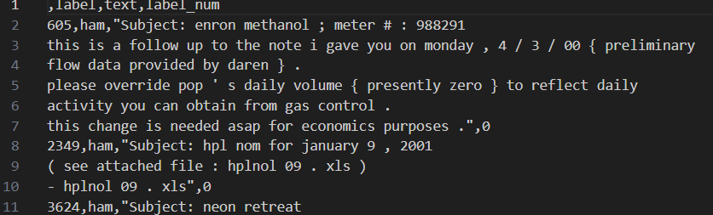
DATASET OVERVIEW
The Dataset Name is spam_ham_dataset.csv
Number of Rows present in this dataset: 5,171.
From the given dataset we can classify whether
The given emails are ham or spam.

Slide 4
DATA PREPROCESSING STEPS
Data Loading: Using pandas to read the CSV file.
Data Preprocessing: In this step the relevant columns are selected.
Data Splitting: In this step the few data are trained and few data are tested.
Email Filtering: One of the primary methods for spam mail detection is email filtering. It involves categorize incoming emails into spam and non-spam. Machine learning algorithms can be trained to filter out spam mails based on their content and metadata.
Text Vectorization: Text Convert text to numerical features using CountVectorizer.
Model Training: Multinomial Naive Bayes (MultinomialNB).

Slide 5
ALGORITHM: NAÏVE Bayes
Model Used: Multinomial Naive Bayes
Why Naive Bayes is used?
Works well with text classification tasks.
Based on Bayes’ Theorem and conditional probabilities.
Fast and efficient for large text datasets.

Slide 6
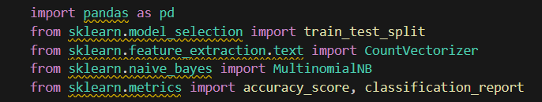
CODE IMPLEMENTATION
pandas → To load and handle the dataset (tables, CSV files).
train_test_split → To split the data into training and testing sets.
CountVectorizer → To convert text messages into numbers (Bag of Words model).
MultinomialNB → A Naive Bayes algorithm used for text classification problems.
accuracy_score & classification_report → To measure model performance.
matplotlib.pyplot → For creating visualizations like pie charts.

Slide 7

Loads the CSV file (e.g., containing columns like text, label, and label_num).
Each row likely represents an email or message labeled as spam or ham (not spam).

Slide 8
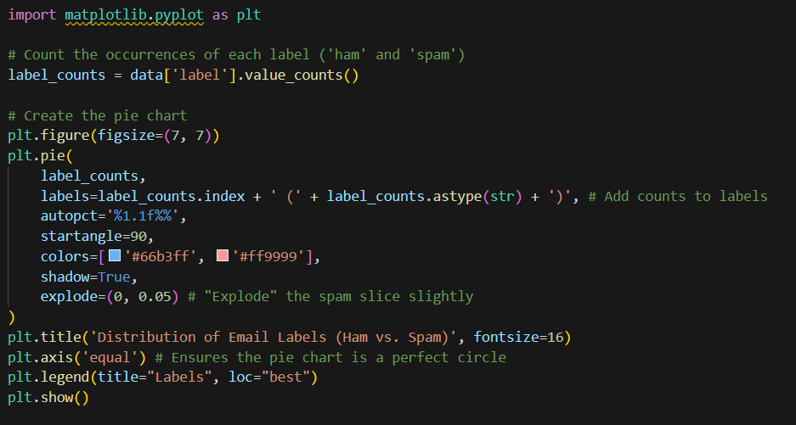
Counts how many spam and ham messages are in the dataset.
Creates a pie chart showing the proportion of each category.

Slide 9


Displays the first five rows to verify data structure — confirms column names and contents.
X → The message content (input feature).
y → Numeric label (0 for ham, 1 for spam).
Splits the data:
80% for training the model.
20% for testing the model’s accuracy.
random_state=42 ensures reproducible results.

Slide 10
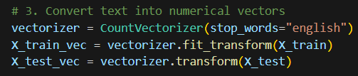

CountVectorizer transforms text into a bag of words (word count matrix).
stop_words="english" removes common words like “the”, “and”, “is”.
fit_transform learns from and transforms training data.
transform only converts test data (using the same learned words.
Initializes a Multinomial Naive Bayes classifier, commonly used for text classification.
The model learns patterns between word frequencies and spam/ham labels.

Slide 11

Predicts whether each test message is spam or ham based on learned patterns.
Accuracy → Shows overall correctness of the model.
Classification Report → Gives:
Precision (how many predicted spams were actually spam),
Recall (how many real spams were detected),
F1-score (balance of precision & recall).

Slide 12
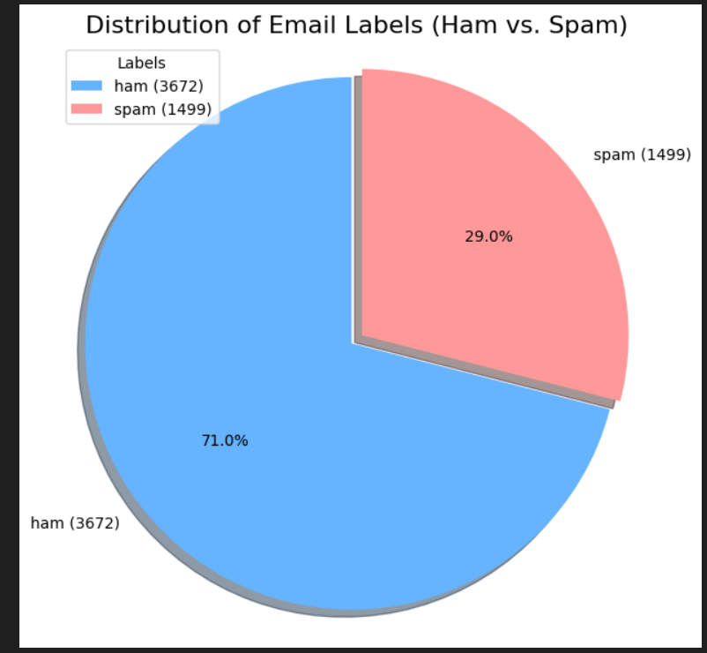
OUTPUT OR RESULTS
Accuracy: 97.10%
Classification Report:
Class | Precision | Recall | F1-Score
Ham | 0.98 | 0.98 | 0.98
Spam | 0.95 | 0.95 | 0.95

Slide 13
INSIGHTS
Naive Bayes is effective for spam detection with minimal preprocessing.
Model accurately distinguishes between spam and ham emails.
Stop words removal improved the model performance.

Slide 14
FUTURE IMPROVEMENTS
Try TF-IDF Vectorization instead of CountVectorizer.
Use advanced models like Logistic Regression or BERT.
Apply text cleaning techniques (remove punctuation, lemmatization).
Build a GUI or Web App for real-time spam detection.

Slide 15
CONCLUSION
Achieved 97% accuracy using Naive Bayes.
Demonstrated effective spam classification using ML techniques.
Shows potential for real-world email filtering applications.

Slide 16
THANK YOU

